Slide 1
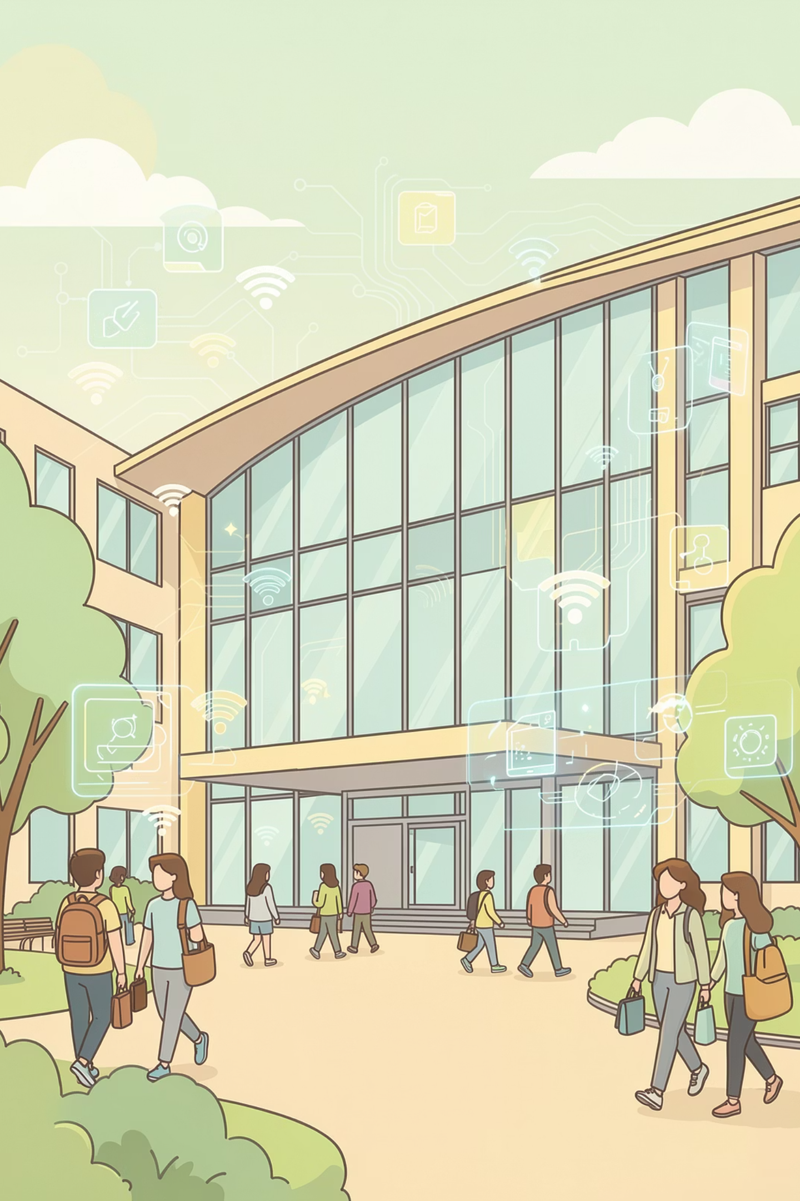
College Smart Complaint System
Smart, Real-Time Institutional Grievance Management System
B.Tech CSE | IILM University, Greater Noida
Student: Shray Singal
Roll no . :- CS-2341299

Slide 2

Introduction to Institutional Complaint Systems
Colleges and universities process thousands of student grievances annually, ranging from academic issues to infrastructure complaints. Traditional systems rely on manual, paper-based workflows that create bottlenecks and reduce efficiency.
Students submit physical forms, wait indefinitely for responses, and often lose track of their complaints. Faculty and administrators struggle with disorganized filing systems, making it nearly impossible to maintain accountability or track resolution timelines.

Slide 3

Background & Motivation
Escalating Complaint Volume
Automation Imperative
Modern institutions receive 500+ complaints monthly, overwhelming manual systems
Digital transformation demands automated workflows to handle growing volumes efficiently
Accountability & Transparency
Real-World Impact
Institutions need visible tracking to build trust and ensure timely resolutions
Improved grievance management directly affects student satisfaction and institutional reputation

Slide 4
Problem Statement
Current college complaint management systems suffer from critical operational deficiencies that hinder institutional effectiveness:
Lost or Delayed Complaints
Absence of Tracking System
No Accountability Mechanisms
Paper-based systems result in misplaced documents and forgotten issues, leaving students without recourse
No visibility into complaint status leaves students in the dark about resolution progress
Without clear ownership and deadlines, complaints languish indefinitely without resolution
Missing Real-Time Updates
Poor Communication Channels
Students receive no notifications about progress, forcing them to repeatedly visit offices
Lack of direct communication between students and faculty creates frustration and delays

Slide 5
Project Objectives
01
02
Centralized Digital Platform
Real-Time Status Tracking
Unified system for all complaint categories accessible to students, faculty, and administrators
Live updates on complaint progress with timestamped milestones visible to all stakeholders
03
04
Role-Based Access Control
SLA Enforcement Engine
Granular permissions ensuring appropriate access levels for different user types
Automated deadline tracking with escalation protocols for overdue complaints
05
06
JWT-Based Security
Administrative Analytics
Encrypted authentication and secure data transmission protecting sensitive information
Comprehensive dashboards providing insights into complaint patterns and resolution metrics

Slide 6
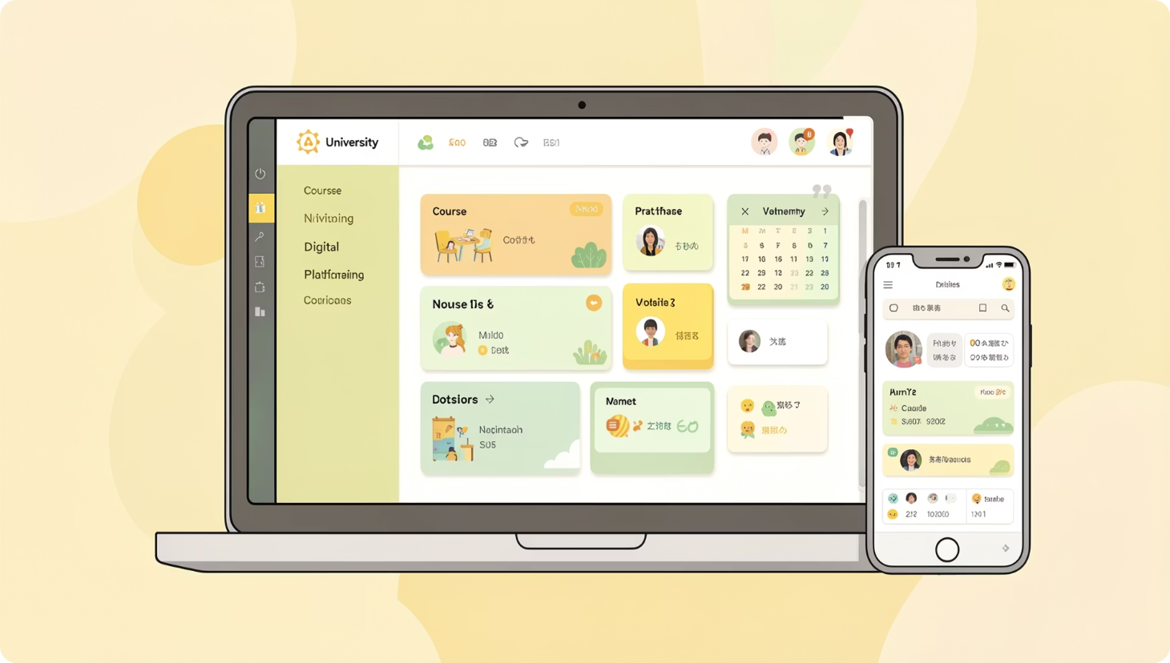
Scope of the Project
Current Implementation
Single-institution deployment at IILM University
Covers entire student body and faculty members
Full complaint lifecycle management from submission to closure
Supports multimedia attachments for evidence documentation
Real-time chat functionality between stakeholders
Future Enhancements
Integration with Learning Management Systems (LMS) and Student Information Systems (SIS) planned for subsequent development phases

Slide 7
User Roles & Permissions
Student
Faculty
Submit complaints with multimedia evidence, track real-time status updates, receive notifications, and communicate directly with resolving faculty
Resolve assigned complaints, upload supporting documentation, communicate with students via chat, and mark issues as complete with proof
Administrator
Master Accounts
Assign complaints to appropriate faculty, monitor overall system performance, generate analytics reports, and enforce SLAs
Reserved for testing purposes, system configuration, and quality assurance activities before production deployment

Slide 8
Key Features Overview
Media-Based Submission
Real-Time Chat
AI Categorization
Socket.io-powered instant messaging enables direct communication between students and faculty
Intelligent tagging automatically classifies complaints by type, department, and priority level
Students can attach images, videos, and documents as evidence when filing complaints
SLA Tracking
Cloud Integration
Automated deadline monitoring with color-coded urgency indicators and escalation protocols
AWS-hosted infrastructure ensures scalability, reliability, and seamless data backup

Slide 9

Literature Study Highlights
Research Findings
Comprehensive analysis of existing complaint management systems revealed significant improvements through digital transformation:
Centralized Management Systems reduce resolution time by 40-60% compared to manual workflows
WebSockets technology improves system responsiveness and user engagement by 75%
AI-based categorization increases complaint routing accuracy by 85% and reduces misclassification
Cloud infrastructure enhances system performance, uptime, and scalability while reducing operational costs

Slide 10




Bridging the Gap: NovaTech's Solution
Proof-Based Resolution
Real-Time Communication
Documentation uploads ensure accountability
Instant chat eliminates office visits
SLA Monitoring
Self-Healing System
Automated deadline enforcement
Auto-escalation prevents complaints from stalling
Existing systems lack comprehensive proof documentation, real-time updates, SLA tracking, and automated escalation mechanisms. NovaTech addresses all these gaps with an integrated platform that combines secure authentication, intelligent categorization, multimedia support, and automated workflows to deliver transparent, efficient grievance management.

Slide 11

NovaTech: Technology Stack & Architecture
Enterprise-grade complaint management system built with modern web technologies and robust architectural patterns.

Slide 12
Full-Stack Technology Stack
Backend
Database
Node.js, Express, Sequelize ORM, REST APIs
PostgreSQL for data storage, Redis for caching
Cloud Services
Real-Time
Cloudinary (media), Twilio (SMS), Nodemailer (email)
Socket.io for WebSocket communication and instant updates

Slide 13
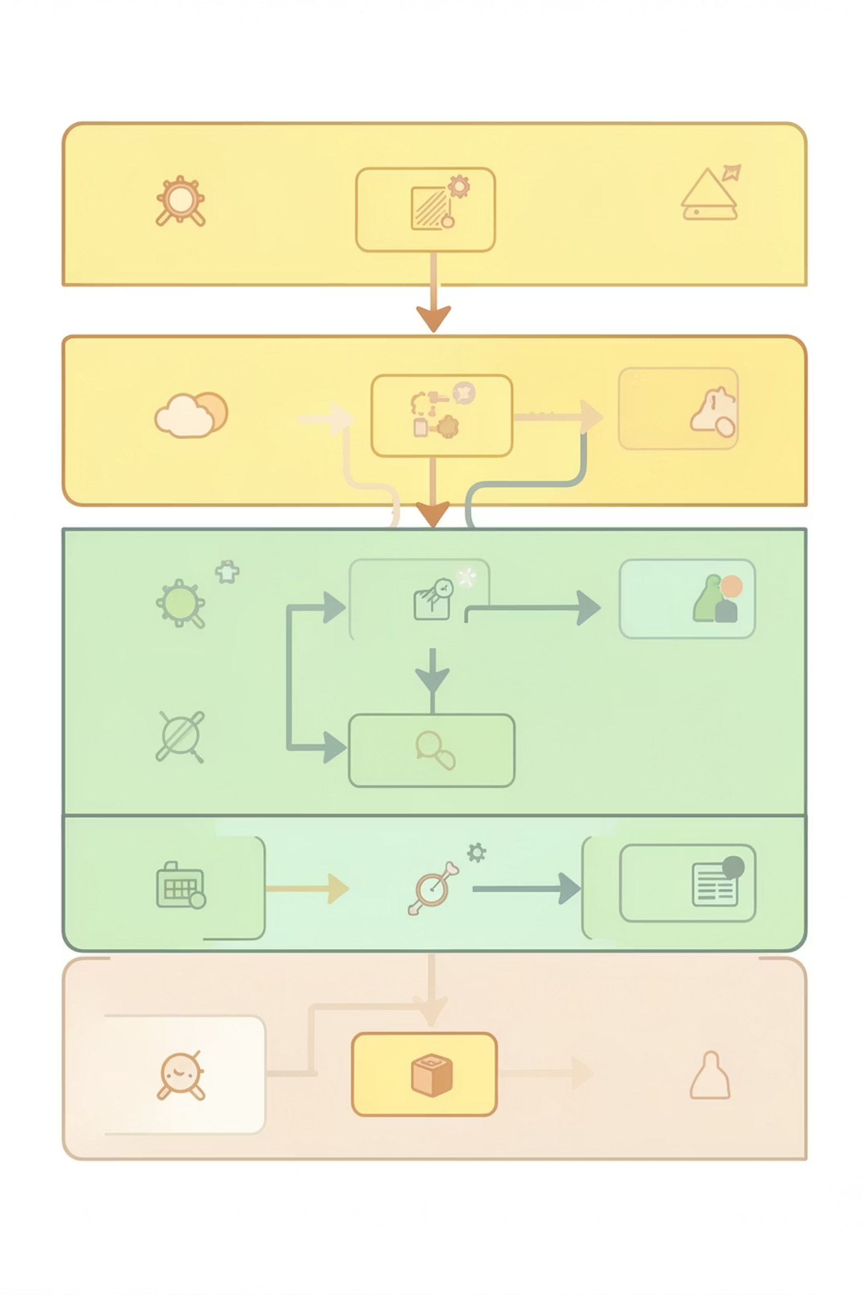




MVC Architecture Overview
Frontend Layer
HTML/CSS/JavaScript templates with responsive UI components
Controller Layer
Express routes handle requests, validate input, manage sessions
Model Layer
Sequelize ORM maps database tables, enforces data integrity
Database Layer
PostgreSQL stores all data with optimized queries and indexes

Slide 14
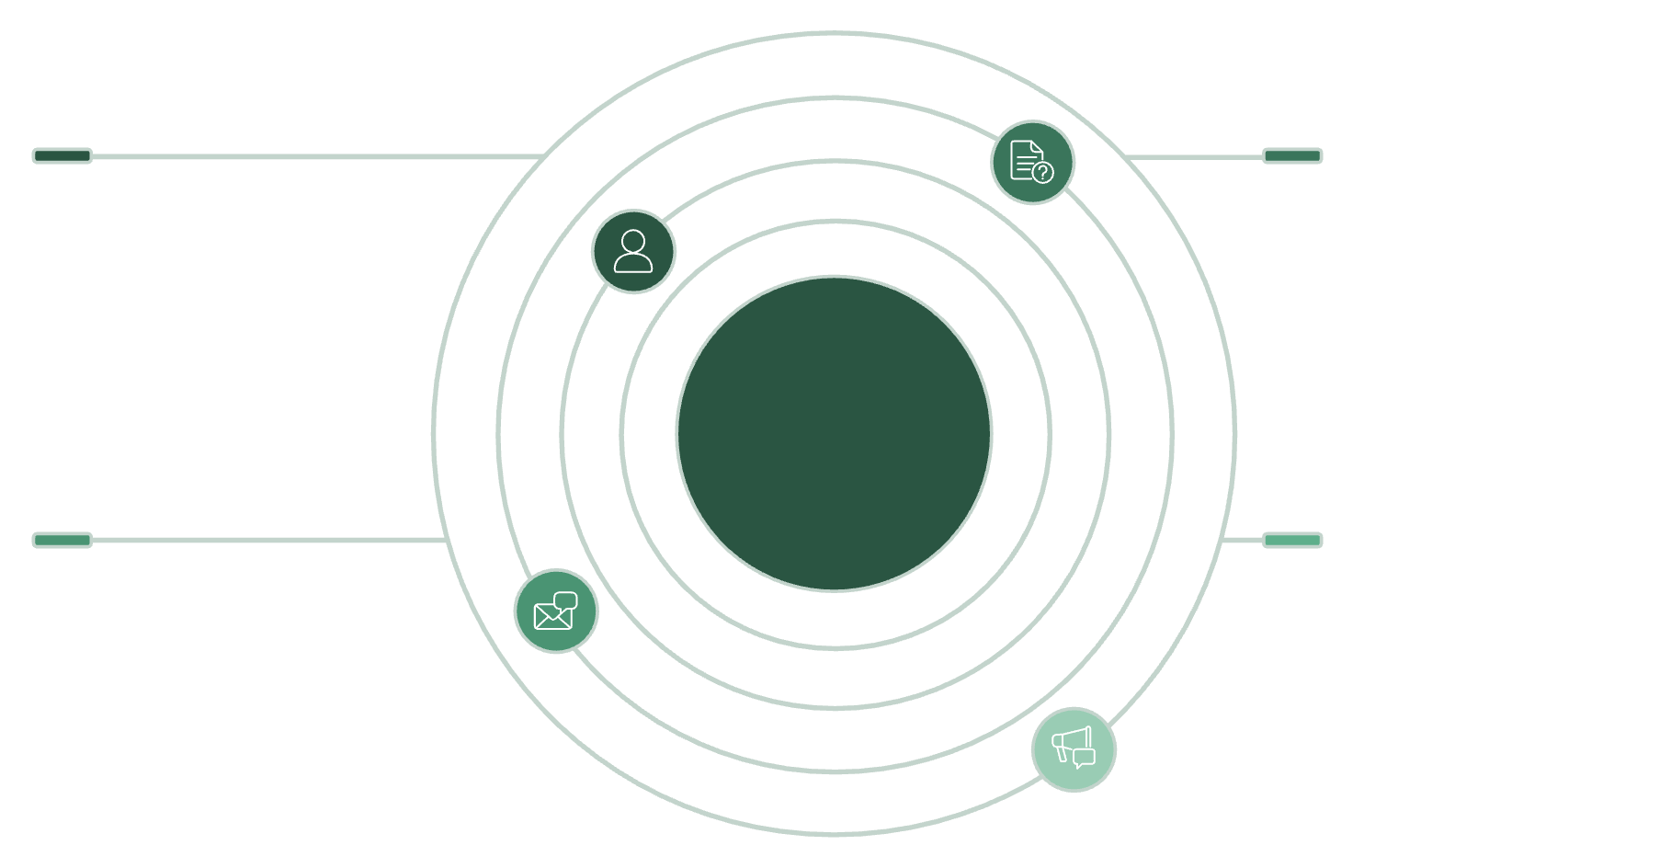
Database Entity Relationship Model
Core Entities
Users
Complaints
Users: Students, staff, and administrators with role-based access
Complaints: Issues with priority levels, categories, and status tracking
Messages: Real-time chat between users and support staff
Feedback: Post-resolution ratings and comments
id, name, email, role — students, staff, admins
id, title, description, priority, status, userId, assignedTo
Entity Relationship Overview
Messages
Feedback
id, content, timestamp, complaintId, userId
id, rating, comment, complaintId, userId

Slide 15
Enterprise Security Architecture
1
2
JWT Authentication
Redis Blacklisting
Stateless tokens with encrypted payloads, automatic token refresh, and session management
Revoked token tracking for immediate session invalidation and security enforcement
3
4
Role-Based Access Control
Rate Limiting
Granular permissions ensuring students, staff, and admins see only relevant data and actions
API protection preventing abuse, DDoS mitigation, and automated throttling by IP address

Slide 16
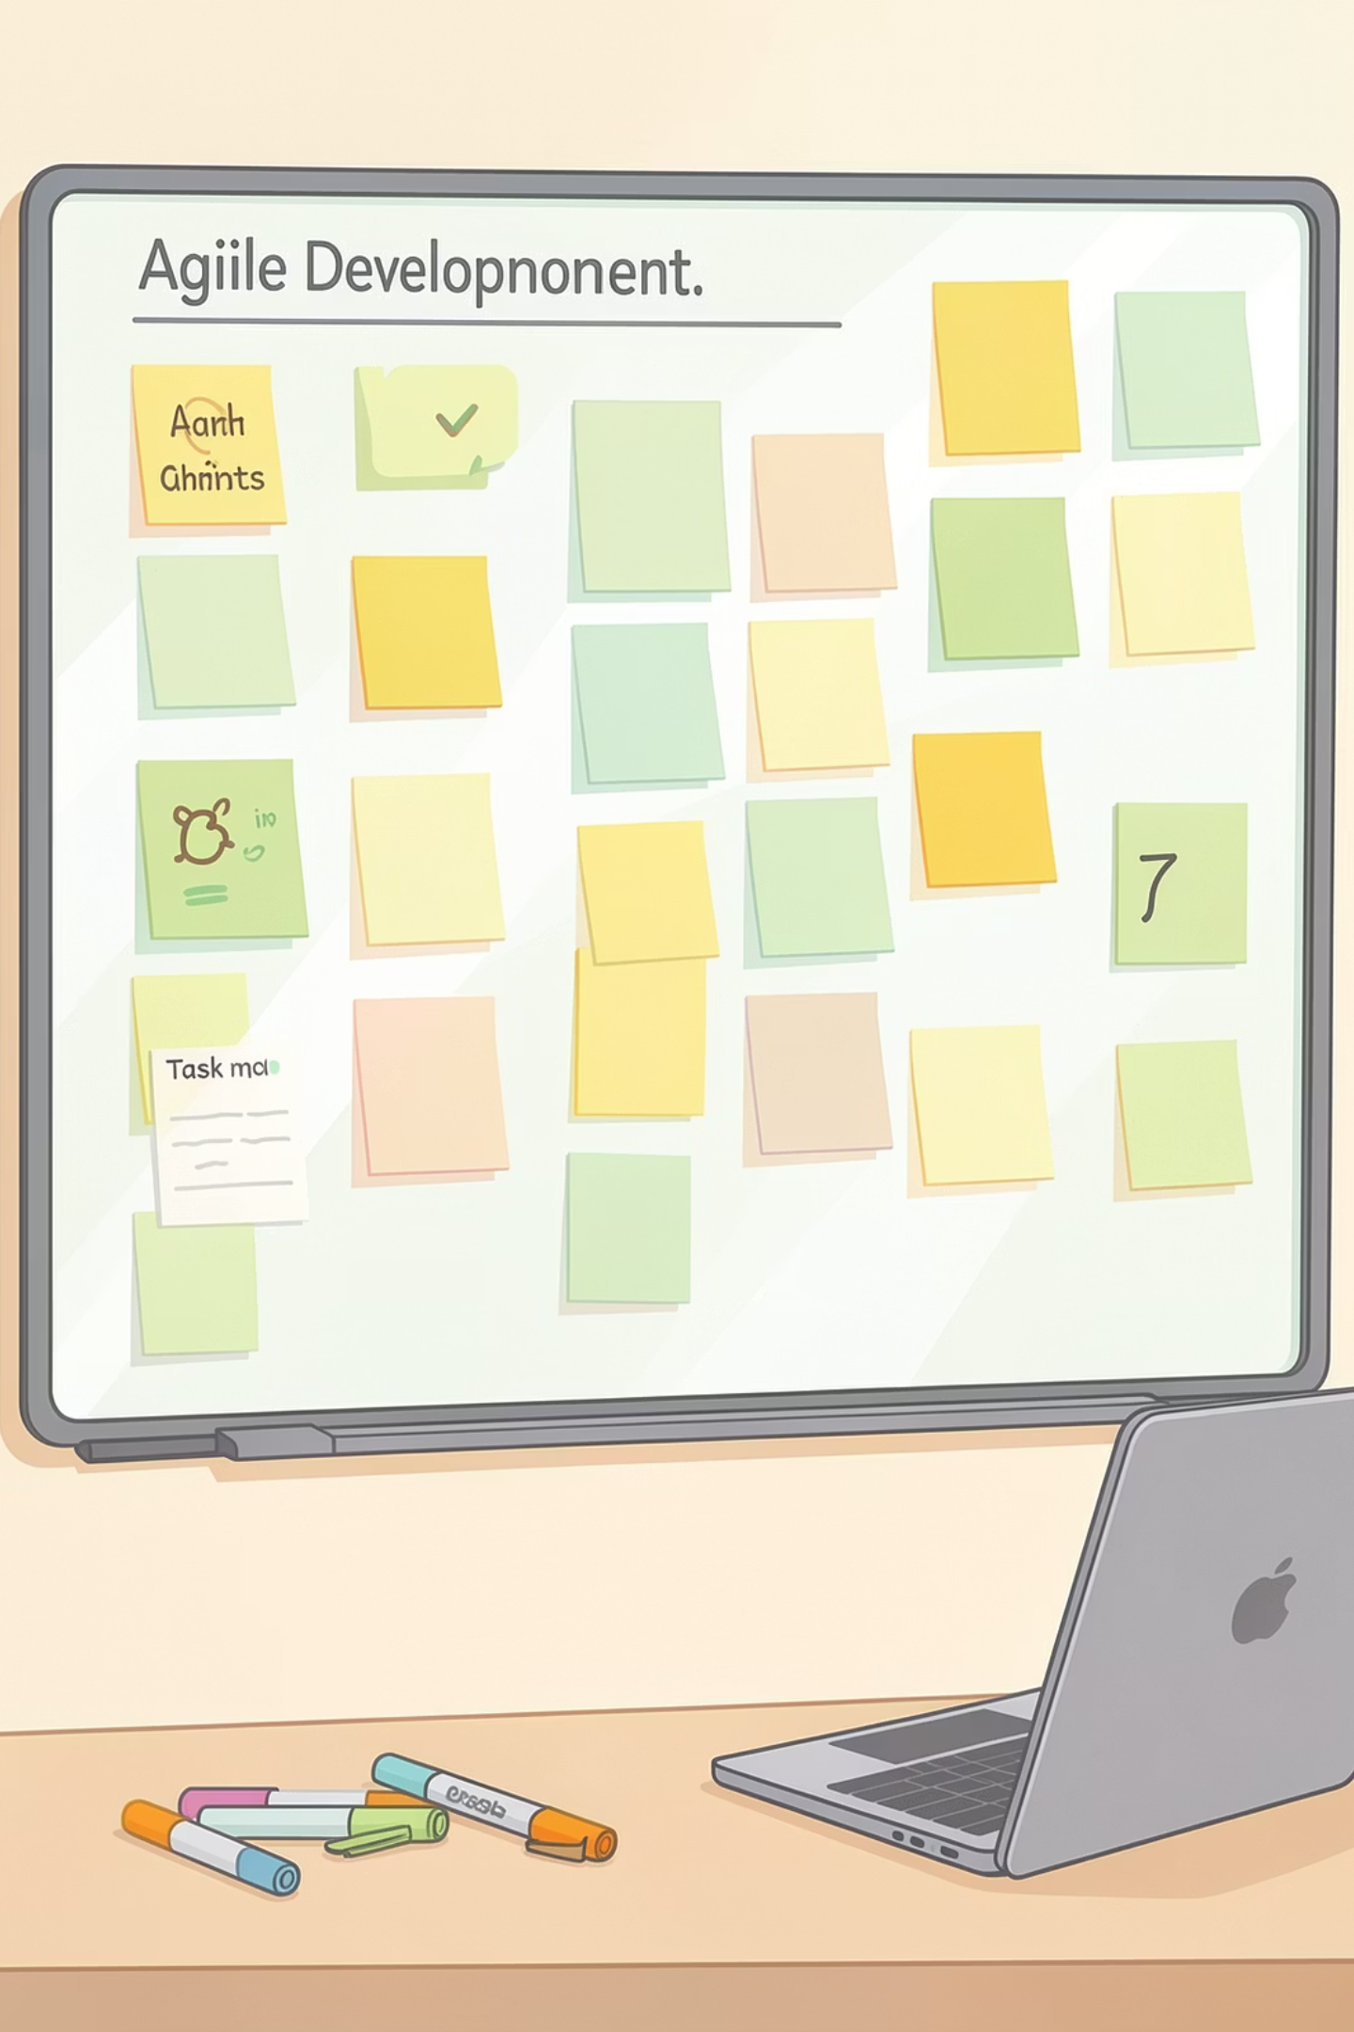
Development Process & AI Integration
Agile Methodology
AI-Powered Intelligence
Four iterative sprints delivering working features:
Keyword-based categorization engine with real-time suggestions and high accuracy at low latency.
Core complaint system & user authentication
Real-time messaging & notifications
SLA tracking & automated alerts
AI categorization & reporting dashboards

Slide 17

SLA Management & Self-Healing System
High Priority
Medium Priority
Low Priority
24 hours
48 hours
72 hours
Critical issues requiring immediate attention
Standard resolution timeframe for most complaints
Non-urgent matters with extended resolution window
Self-Healing Watchdog: Automatic database and Redis reconnection with 99.9% uptime guarantee

Slide 18
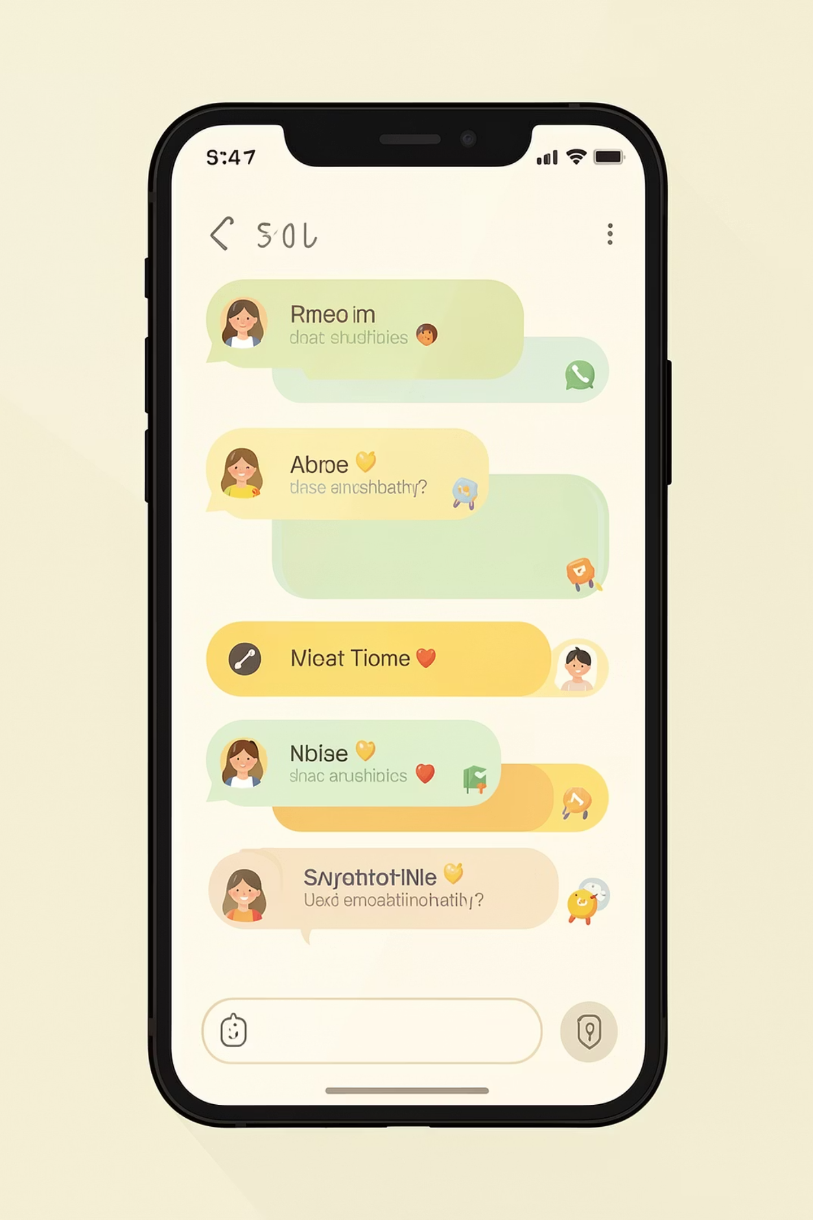
Real-Time Communication Systems
Instant Notifications
Socket.io delivers real-time updates to dashboards, ensuring immediate awareness of new complaints and status changes
Complaint Chat Rooms
Dedicated messaging channels for each complaint, enabling direct communication between students and support staff
Automated Email System
Triggered emails for account activation, complaint acknowledgment, and resolution confirmation with professional templates

Slide 19
Performance Metrics & User Feedback
System Performance
Feature Validation
User Satisfaction
Dashboard analytics: <100ms
Complaint loading: <500ms
Real-time notifications: <200ms
RBAC permissions verified
JWT blacklist functioning
SLA detection active
Media uploads successful
92% found system easy to use
90% liked real-time updates
85% satisfied with UI design

Slide 20
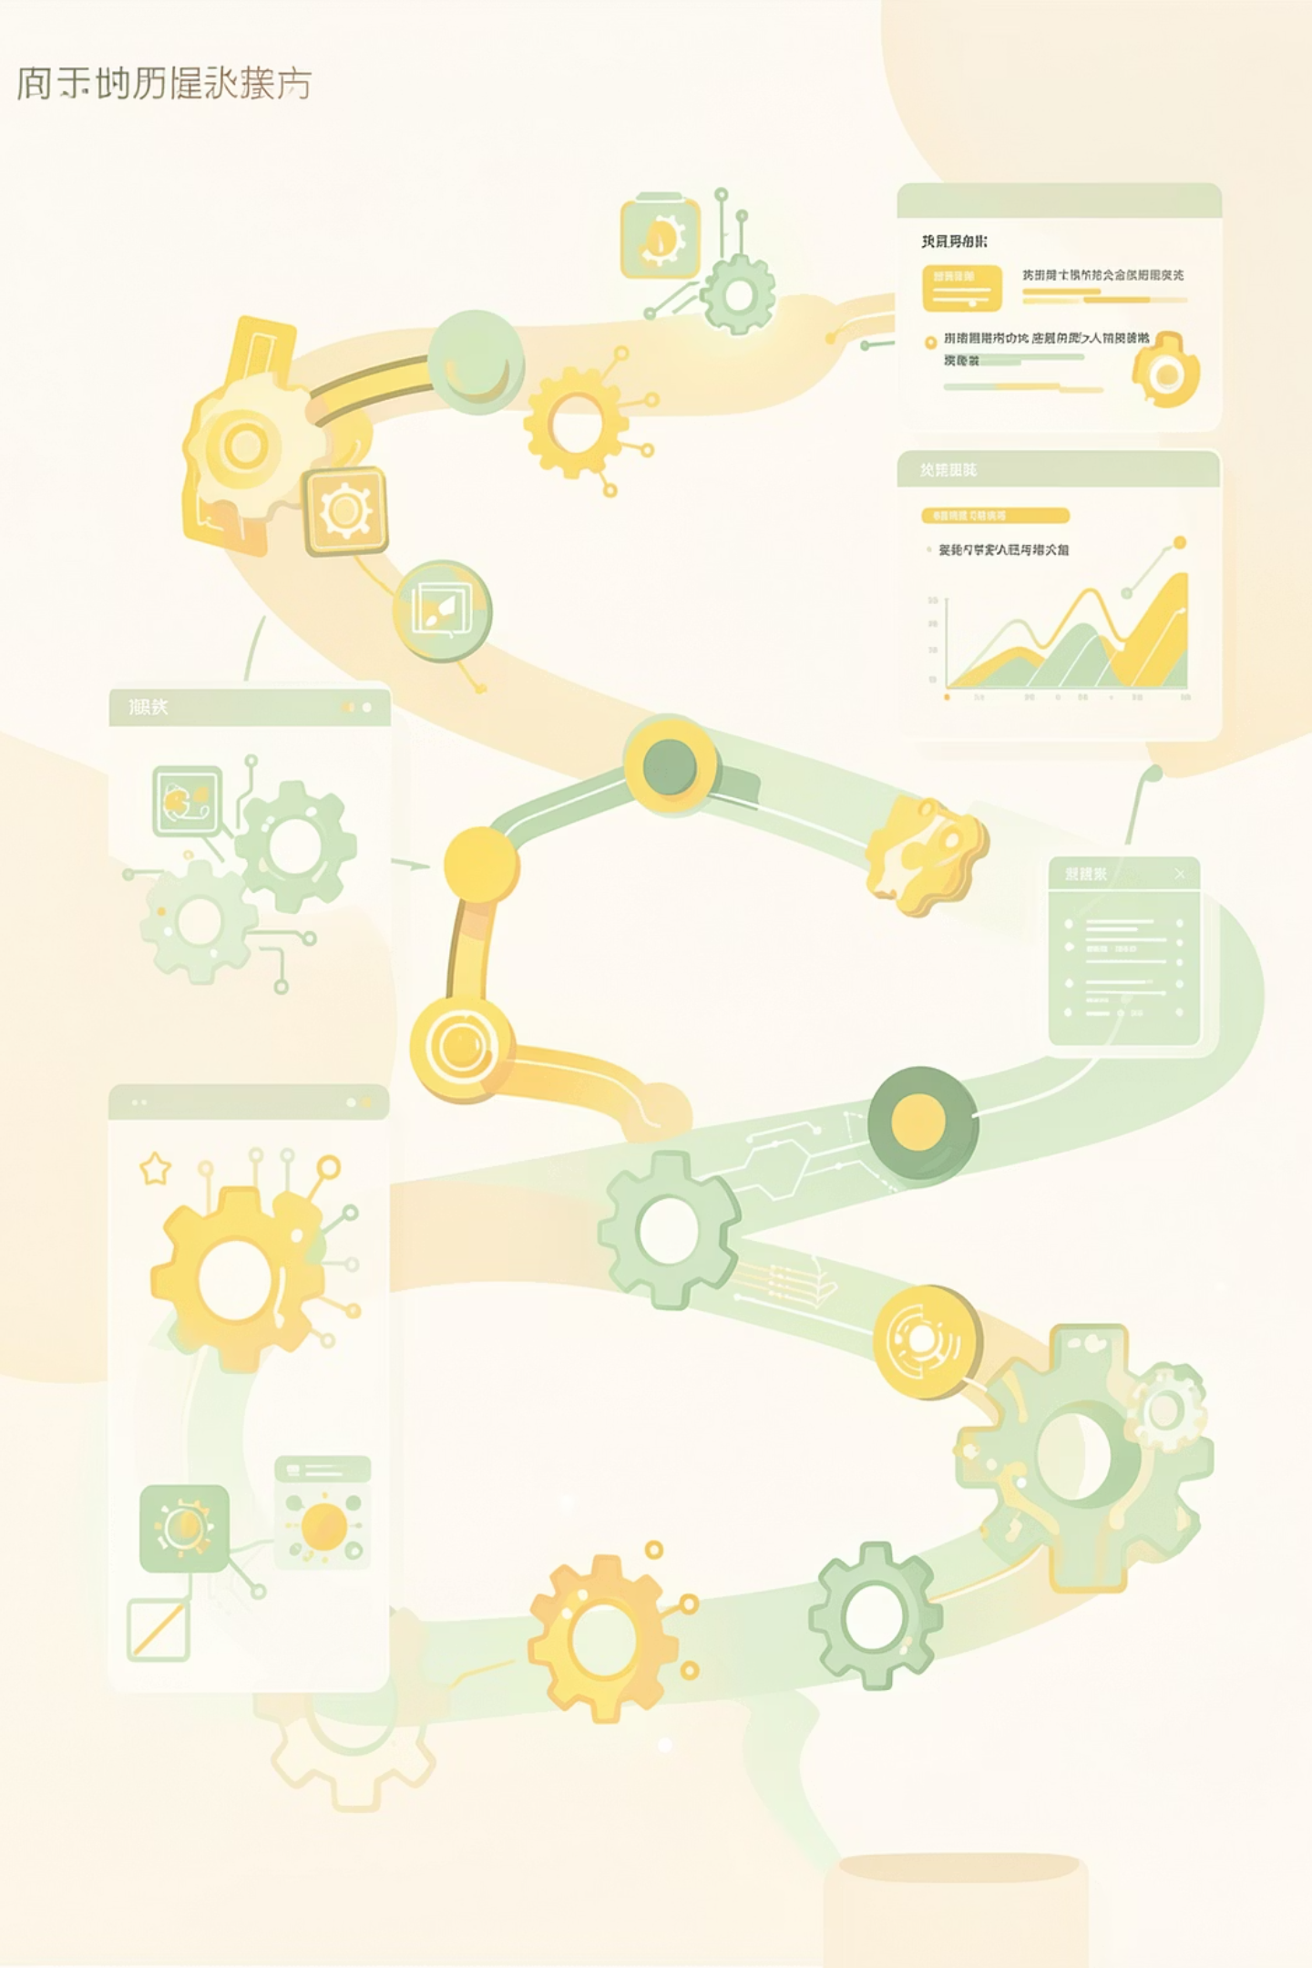
Future Roadmap & Thank You
1
Phase 1: ML Categorization
Machine learning models for intelligent complaint classification and routing
2
Phase 2: Mobile App
React Native application for iOS and Android platforms
3
Phase 3: LMS Integration
Direct connection with Canvas, Blackboard, and Moodle systems
4
Phase 4: Multi-Campus
Support for university systems with multiple geographic locations
Thank You
Questions?

